Slide 1
ADMISSION DATA EXPLORER
Learning Pathway: Generative AI and Data Science
Hands-on Project
Nabila Ahmad
SIWES — FlexiSAF Edusoft Limited

Slide 2
PROJECT DESCRIPTION
Students will build a python-based data analysis dashboard to explore applicants data such as gender distribution, program preferences, and admission outcomes. Using pandas, matplotlib and seaborn, they will clean, analyze and visualize datasets representing real-world scenarios.
PROJECT GOALS:
To clean and visualize applicants dataset, demonstrating mastery in EDA (Exploratory Data Analysis) Techniques.
TARGET AUDIENCE:
Admissions analyst and students learning data storytelling.

Slide 3
Project Overview
Admission Data Explorer is a data analysis project focused on college admission data.
The project uses Python for data cleaning, analysis, visualization, and insight generation.
The project explores applicant demographics, programme preferences, academic performance, and admission outcomes.
A rule-based system was also developed to automatically generate plain-English insights from the analysis.
2

Slide 4
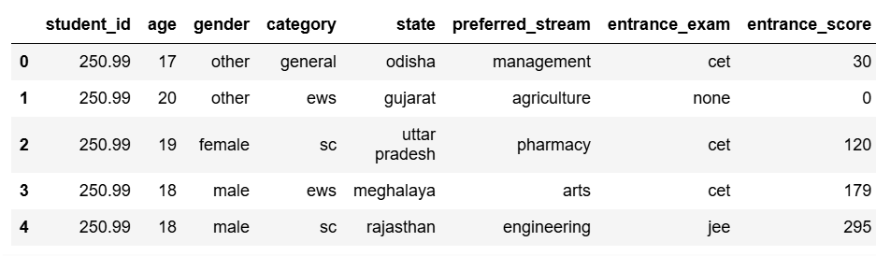
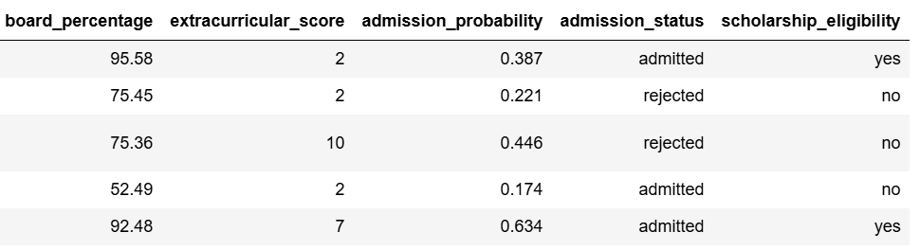
Dataset Information
Dataset: College Admission Dataset (India)
Source: Kaggle
Original Credit: Kundan Sagar Bedmutha
Size: 25,000 rows ,13 columns
3

Slide 5
Methods
Data Cleaning
EDA
Visualizations
Load dataset
Missing values
Duplicates
Data types
Inconsistencies
Outliers
Acceptance rate
Rejection rate
Gender ratios
Top 5 programs by
demand
Used charts to identify outliers and present key data distributions. Bar plot, pie chart, box plot.
AI Powered
Feature
Rule-based feature that automatically turns data analysis results into short, story-like insights..

Slide 6
Methods
LOAD THE DATASET
Imported the dataset from a CSV file using Pandas, with error handling for malformed data.
Stored the dataset in a DataFrame called data.
Displayed the first few rows to understand the structure of the data.
DATA CLEANING
Dataset size: 25,000 rows × 13 columns.
Columns: student_id, age, gender, category, state, preferred_stream, entrance_exam, entrance_score, board_percentage, extracurricular_score, admission_probability, admission_status, scholarship_eligibility.
Missing values: No null values found.
Duplicates: No duplicate records found.
Data types: Numerical and categorical data types were identified and checked.
Descriptive statistics: describe() was used to examine the numerical columns.
Inconsistent values: No inconsistent categorical values were found.
Outliers: Detected in entrance_score and admission_probability using boxplots and the IQR method.
Outlier handling: Outliers were investigated based on the different scoring ranges of the entrance exams and were retained rather than automatically removed, as they could represent valid observations.

Slide 7
Methods
EXPLORATORY DATA ANALYSIS (EDA)
Admission outcome: 32.61% admitted and 67.39% rejected.
Gender ratios: Other – 8,387 : Male – 8,364 : Female – 8,249.
Gender admission rates: Female – 32.69%; Male – 32.01%; Other – 33.12%.
Top 5 preferred programmes: Management, Arts, Nursing, Architecture, and Agriculture.
Admission comparison: Admitted applicants had higher average entrance scores, board percentages, extracurricular scores, and admission probabilities than rejected applicants.
Visual analysis: Charts were used to identify patterns and communicate the findings clearly.

Slide 8
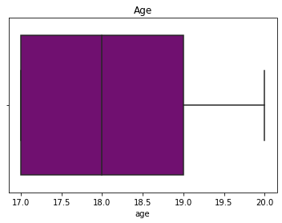
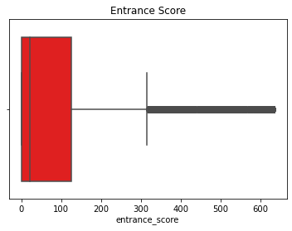
VISUALIZATIONS
Checking for outliers using Visual method (boxplot)

Slide 9
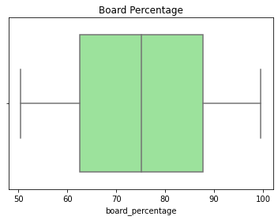
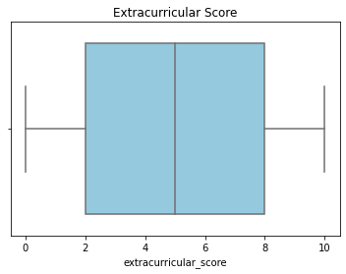
VISUALIZATIONS
Checking for outliers using Visual method (boxplot)

Slide 10
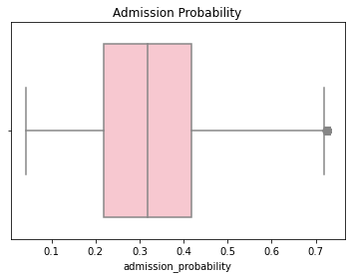
VISUALIZATIONS
Checking for outliers using Visual method (boxplot)
As shown in the figures, boxplots were used to identify potential outliers, indicated by points extending beyond the whiskers.

Slide 11
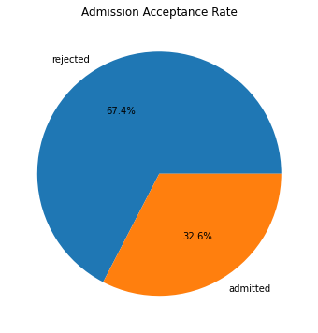
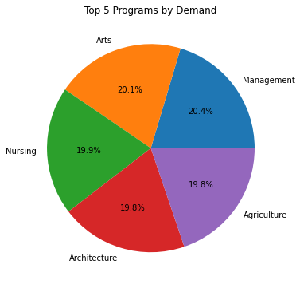
VISUALIZATIONS
Proportion Analysis Using Pie Charts

Slide 12
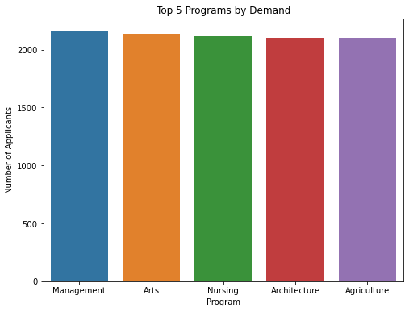
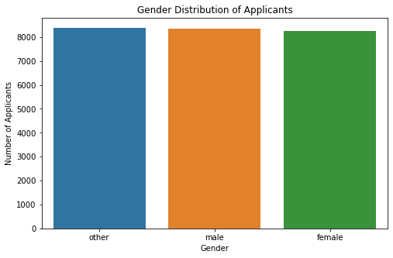
VISUALIZATIONS
Distribution Analysis Using Bar Charts

Slide 13
MODEL RESULTS: RULE BASED
RULE-BASED INSIGHTS
Looking at the admission results, 32.61% of applicants were admitted, meaning fewer than half of the applicants gained admission.
Among the applicants, the other group had the highest number of applicants, with 8,387 students.
When we look at programme preferences, Management was the most popular choice, attracting 2,163 applicants.
The data also shows a difference in entrance scores. Applicants who were admitted had an average score of 106.92, compared with 63.83 for rejected applicants.

Slide 14
thank you

